Slide 1
Deep Learning CS60010
Abir Das
Assistant Professor
Computer Science and Engineering Department
Indian Institute of Technology Kharagpur
http://cse.iitkgp.ac.in/~adas/

Slide 2
Agenda
The Building Blocks of Convolutional Neural Networks/CNNs/ConvNets

Slide 3
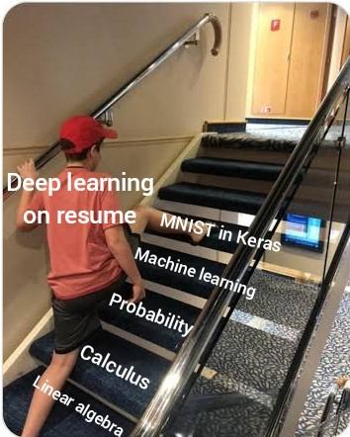
Importance of MNIST

Slide 4

MNIST
database of handwritten digits
10 classes
Training set 60,000 images
Test set of 10,000 images
Greyscale images of size 28x28
Often treated as `Hello World’ for any ML/DL practitioner
Image taken from Researchgate

Slide 5
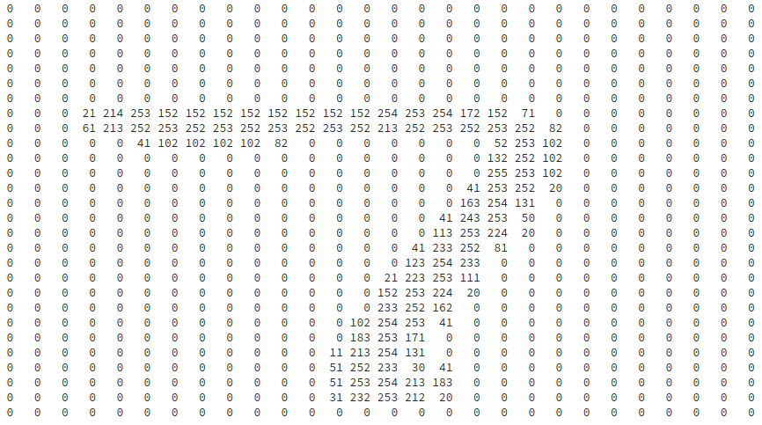
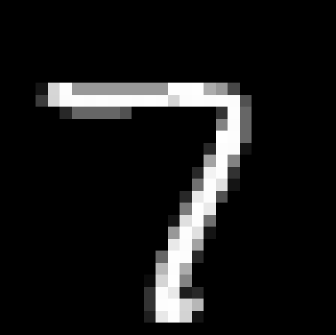

Example from MNIST

Slide 6
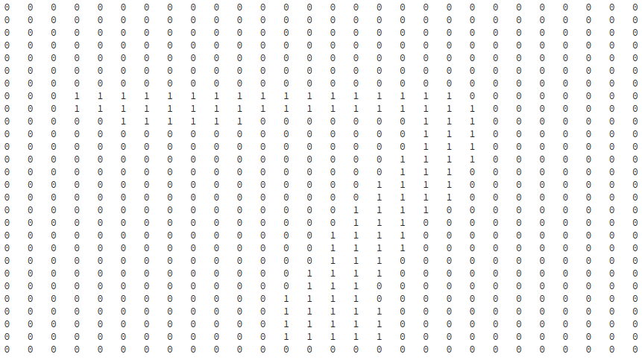

7 Like Window?

Slide 7
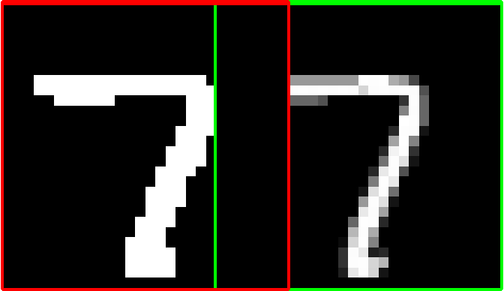
Filtering
0

Slide 8
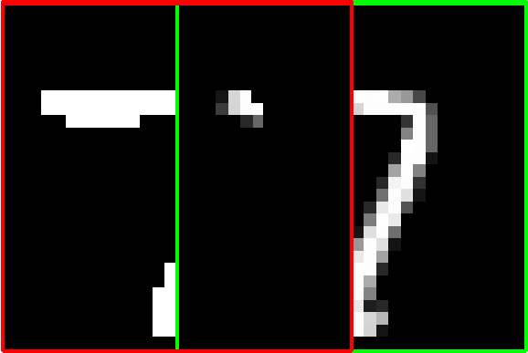
Filtering
1410

Slide 9
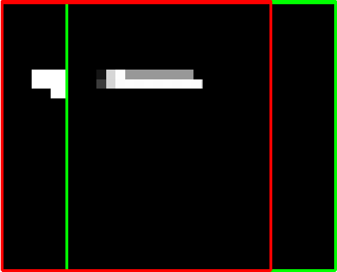
Filtering
4098

Slide 10
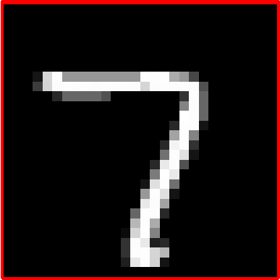
Filtering
18604

Slide 11
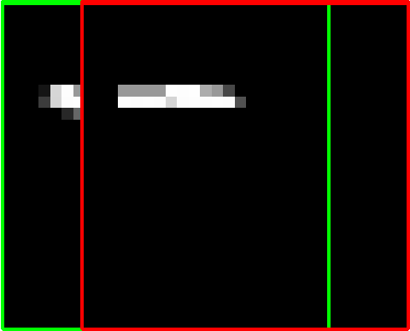
Filtering
4331

Slide 12
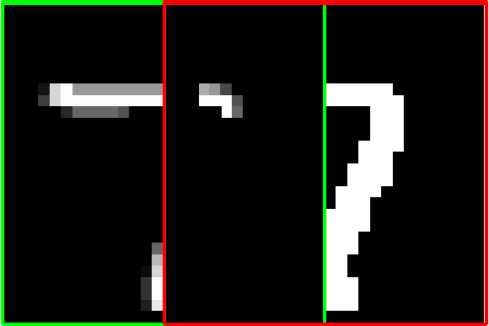
Filtering
1589

Slide 13
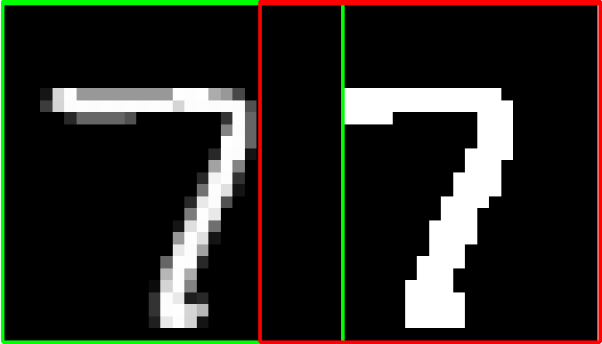
Filtering
0

Slide 14






Filters
Classification by Matching Filters
Test Images
But what if the test image is a little
Rotated (or)
Skewed (or)
Zoomed out and so on

Slide 15
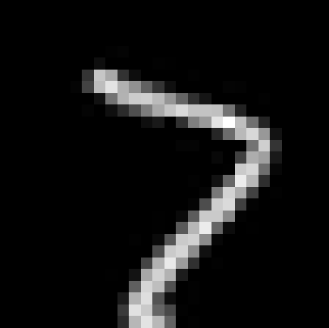

Effect of Slight Rotation
18604
18 degrees
rotation
9974
10278

Slide 16
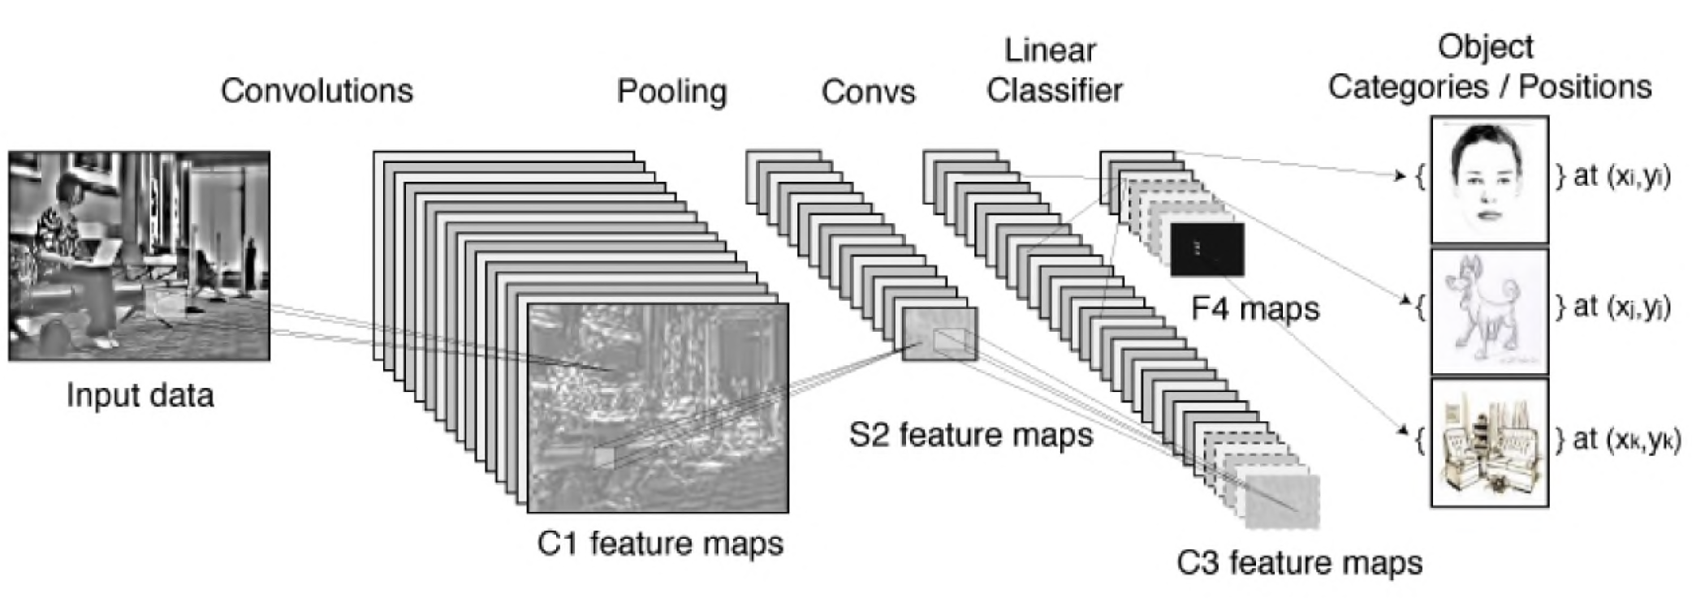
Convnets (Fukushima, LeCun, Hinton)
Slide courtesy: Nando de Freitas, University of Oxford

Slide 17
Convnets (Fukushima, LeCun, Hinton)
Slide courtesy: Nando de Freitas, University of Oxford

Slide 18
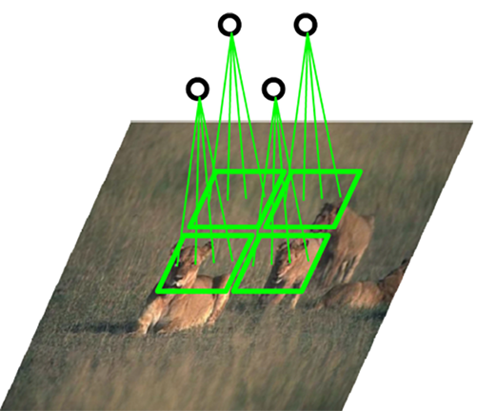
Convnets (Fukushima, LeCun, Hinton)
Slide courtesy: Nando de Freitas, University of Oxford

Slide 19
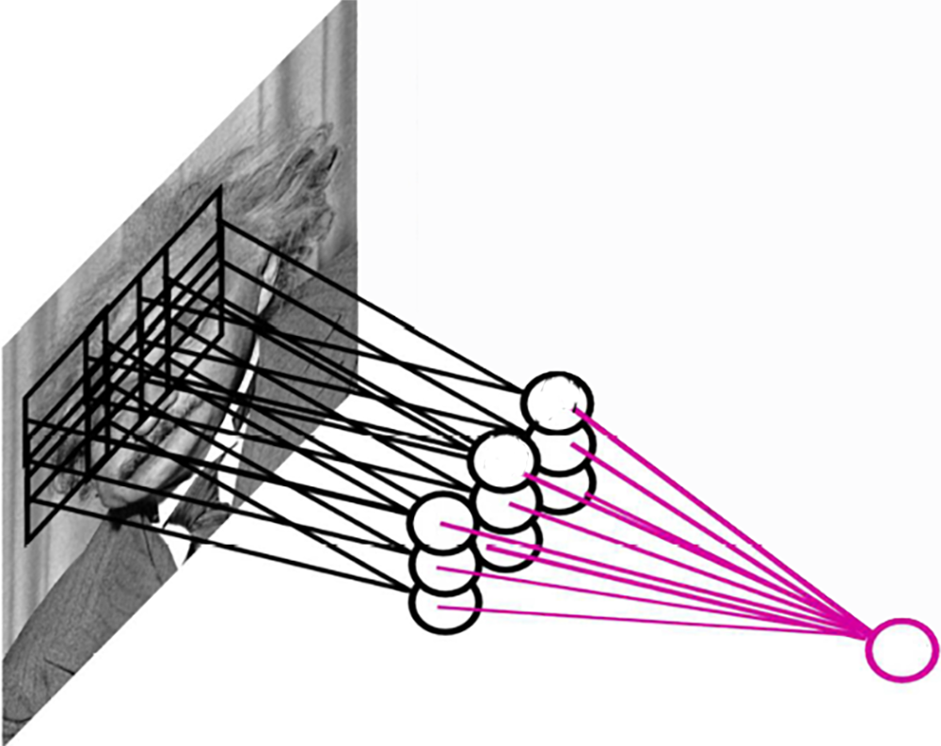
Pooling
By "pooling" (e.g., max or average) filter responses, we gain robustness to the exact spatial location of features.
Image courtesy: Nando de Freitas, University of Oxford

Slide 20
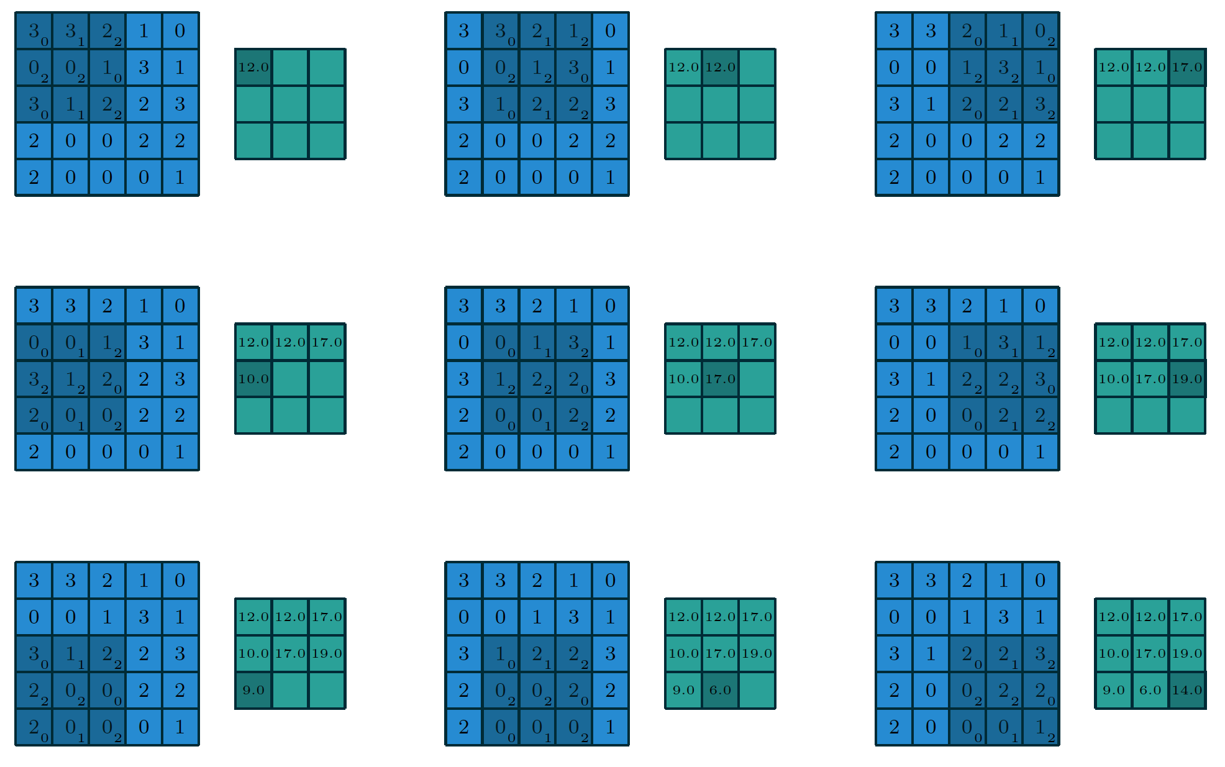
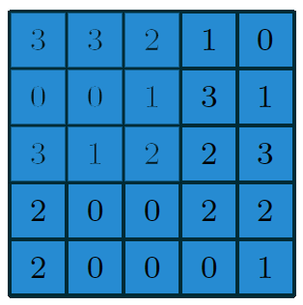
Convolution
Filter
Image
Image courtesy:Vincent Dumoulin

Slide 21
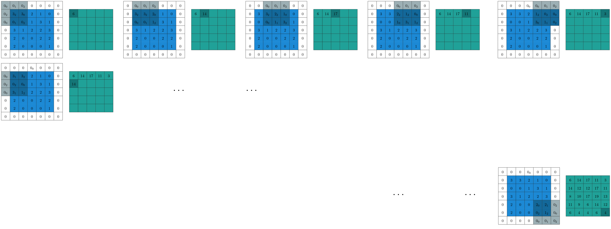
Convolution with Zero Padding
Filter
Image

Slide 22
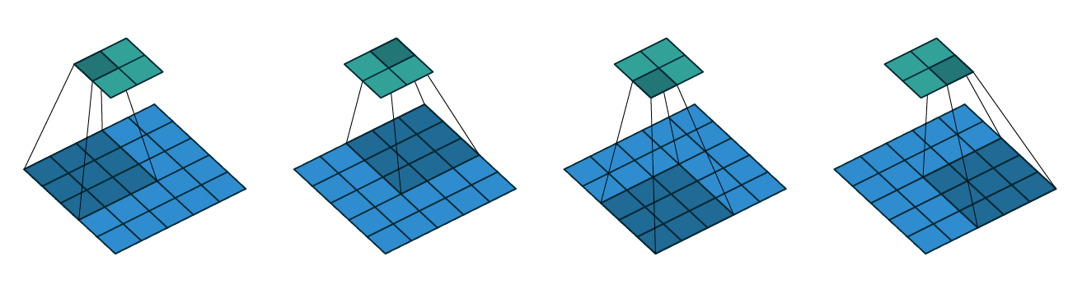
Convolution with Strides
Convolving a 3x3 kernel over a 5x5 input using 2x2 strides
Image courtesy:Vincent Dumoulin

Slide 23

Convolution with Strides and Zero Padding
Convolving a 3x3 kernel over a 5 x5 input using 1 x1 strides and half padding
Image courtesy:Vincent Dumoulin

Slide 24
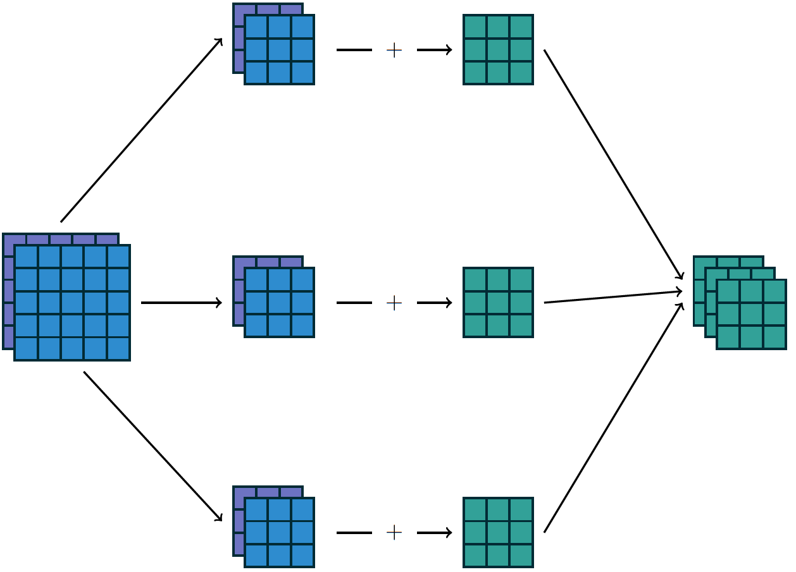
Inputs Generally have Multiple Channels
Image courtesy:Vincent Dumoulin

Slide 25
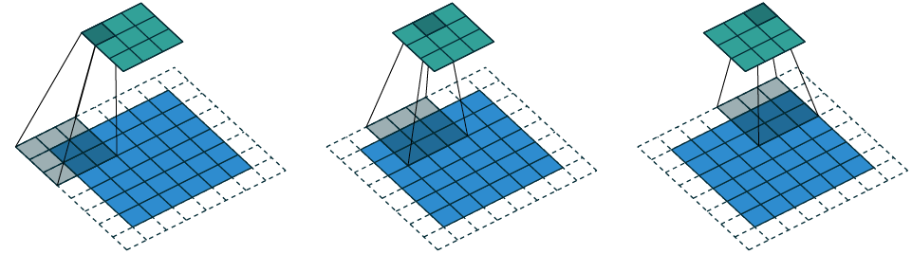
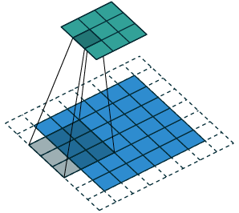
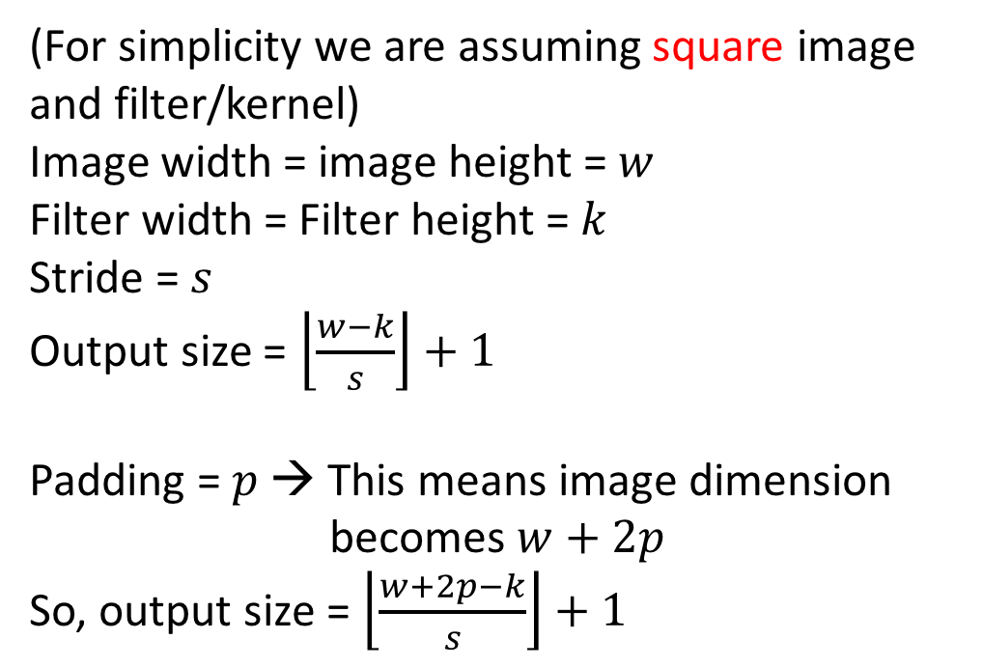
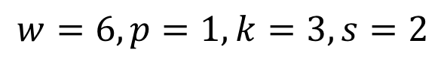
Convolution Arithmetic
(For simplicity we are assuming square image
and filter/kernel)
Image width = image height = $w$
Filter width = Filter height = $k$
Stride = $s$
Output size = $\left\lfloor \frac{w−k}{s}\right\rfloor +1$
Padding = $p$ → This means image dimension
becomes $w+2p$
So, output size = $\left\lfloor \frac{w+2p−k}{s}\right\rfloor +1$
Note the box function
$$w=6, p=1,k=3, s=2$$
Image courtesy:Vincent Dumoulin

Slide 26
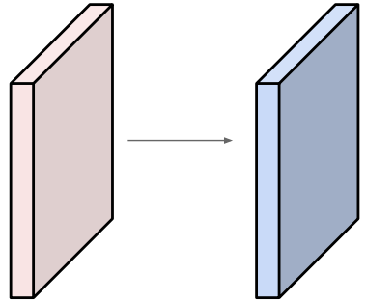
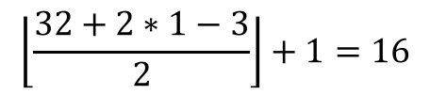
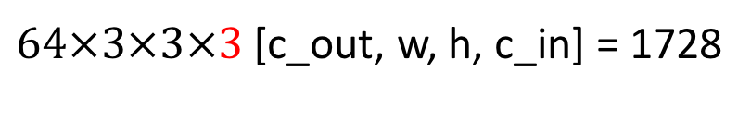

Convolution Arithmetic
Input volume: 32x32x3 [w, h, c].
64 filters of size 3x3 [k, k] with
stride 2 [s], pad 1 [p]
What is the output feature map size?
And What is the number of parameters in this convolution layer?
$$\left\lfloor \frac{32+2∗1−3}{2}\right\rfloor +1=16$$
So, $16×16×64$ [w, h, c]
$64×3×3×3$ [c_out, w, h, c_in] = 1728
Image courtesy: Andrej Karpathy

Slide 27
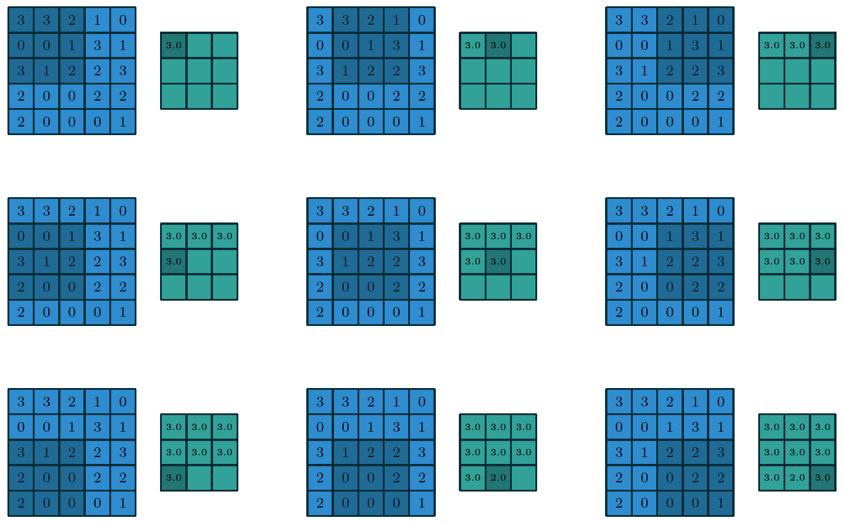
Pooling
3x3 max-pooling on 5x5 input with
1x1 stride
Image courtesy:Vincent Dumoulin

Slide 28
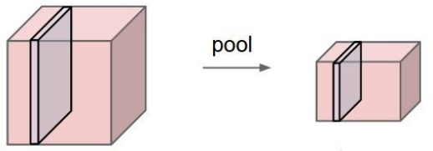
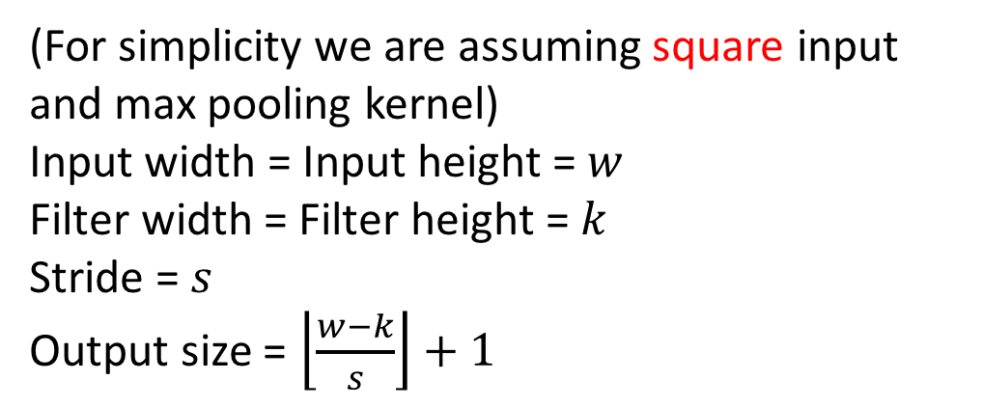


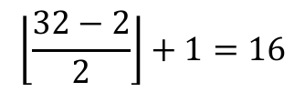
Pooling Arithmetic
(For simplicity we are assuming square input
and max pooling kernel)
Input width = Input height = $w$
Filter width = Filter height = $k$
Stride = $s$
Output size = $\left\lfloor \frac{w−k}{s}\right\rfloor +1$
And What is the number of parameters in this pooling layer?
Input volume: 32x32x3 [w, h, c].
Max-pooling kernel of size 2x2 [k, k] with
stride 2 [s]
What is the output feature map size?
$$0$$
$$\left\lfloor \frac{32−2}{2}\right\rfloor +1=16$$
So, $16×16×3$ [w, h, c]
Image courtesy: Andrej Karpathy

Slide 29
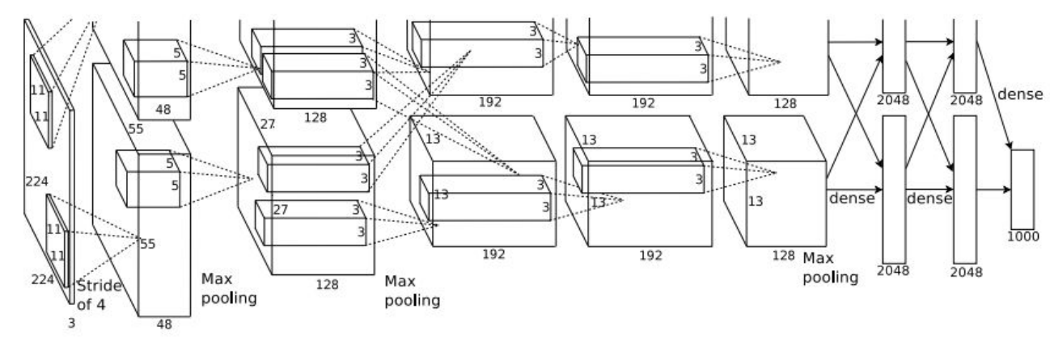
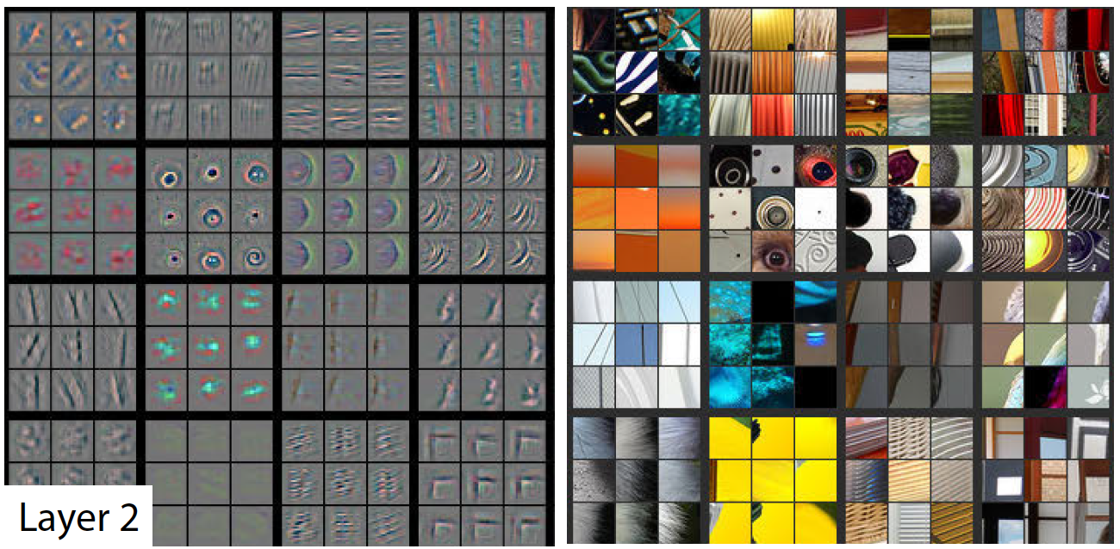
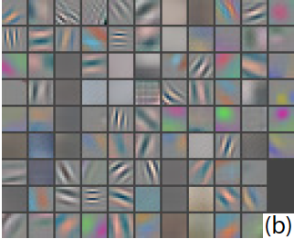
Visualizations
AlexNet (2012)
First layer (CONV1): 96 11x11 filters
Image courtesy: Zeiler, Fergus, 2013

Slide 30
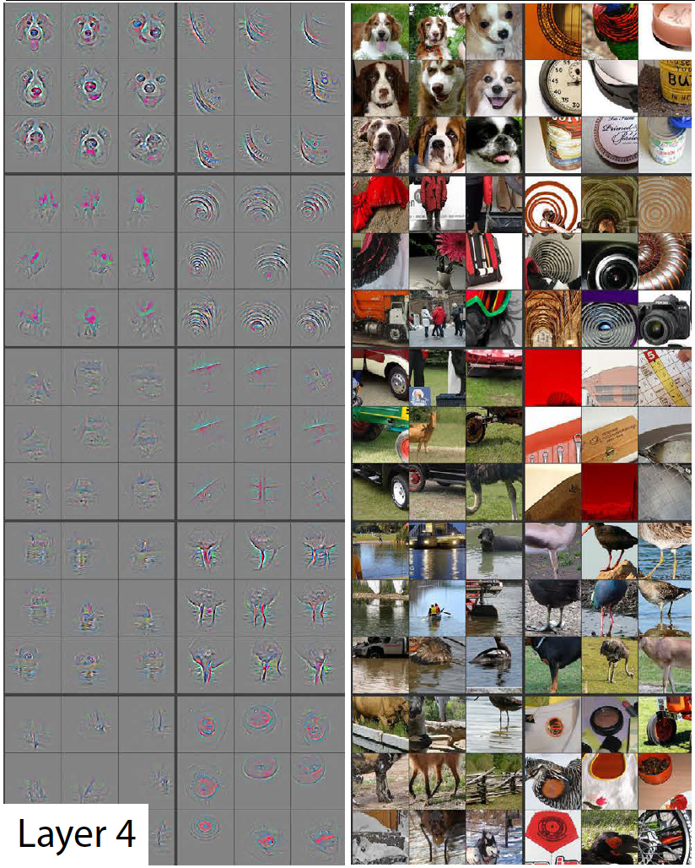
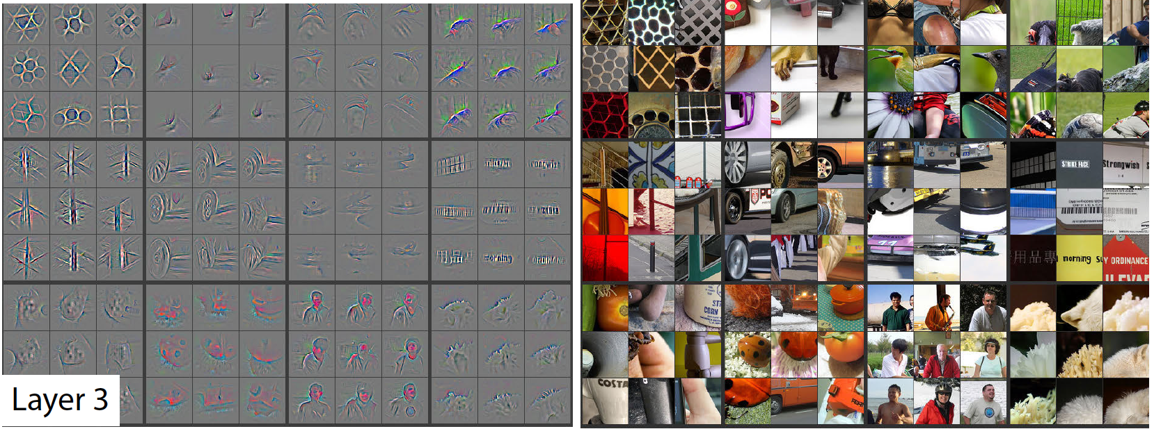
Visualizations
Image courtesy: Zeiler, Fergus, 2013

Slide 31
